Slide 1
Evaluation of Association Patterns

Slide 2
Evaluation of Association Patterns
Association analysis algorithms have the potential to generate a large number of patterns.
In real commercial databases we could easily end up with thousands or even millions of patterns, many of which might not be interesting.
Very important to establish a set of well­-accepted criteria for evaluating the quality of association patterns.
Measures of Interestingness.

Slide 3
Measures of Interestingness
Objective Interestingness Measures
Used to rank patterns
Some provide statistical information.
Eg: Support, Confidence, Lift, Correlation
Subjective measures of Interestingness
Pattern is interesting if it is unexpected.
For eg: {bread}-> {butter} may not be interesting even with high support and confidence values, because it is rather obvious.
But, {Diapers}-> {Beer} is interesting because it is unexpected and suggest a new cross selling opportunity for retailers.
Incorporating subjective knowledge for evaluation is a difficult task because it requires a considerable amount of prior information from domain experts.

Slide 4
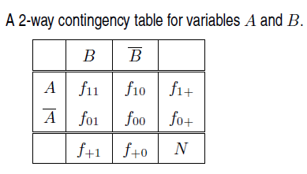
Objective Measures of Interestingness
An objective measure is a data-driven approach for evaluating the quality of association patterns.
It is domain-independent and requires only that the user specifies a threshold for filtering low-quality patterns.
An objective measure is usually computed based on the frequency counts tabulated in a contingency table.

Slide 5
Limitations of the Support-Confidence Framework
The classical association rule mining formulation relies on the support and confidence measures to eliminate uninteresting patterns.
The drawback of support is that many potentially interesting patterns involving low support items might be eliminated by the support threshold.
The drawback of confidence is that despite having high confidence value, the rule could be misleading.

Slide 6
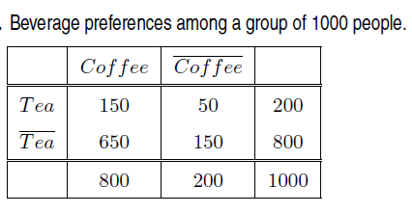
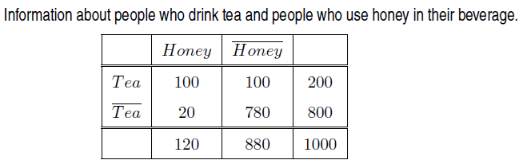
Consider the association rule {Tea} −→{Coffee}
Support = f(T ^C)/N = 150/1000=15%
Confidence= f(T ^C)/f(T) = 150/200 = 75%
Fraction of people who drink coffee = 800/1000= 80%
Therefore, knowing that a person is a tea drinker reduces the possibility of being a coffee drinker from 80% to 75%.
This misleading.
Evaluate {Tea}->{Honey}
Confidence as a measure
can falsely accept or reject a rule.

Slide 7

The support s(A,B) of a pair of a variables A and B measures the probability of the two variables occurring together.
Hence, the joint probability P(A,B) can be written as
If we assume A and B are statistically independent, i.e. there is no relationship between the occurrences of A and B, then P(A,B) = P(A) × P(B).
Hence, under the assumption of statistical independence between A and B, the support s_{indep}(A,B) of A and B can be written as
If the support between two variables, s(A,B) is equal to s_{indep}(A,B), then A and B can be considered to be unrelated to each other.
If s(A,B) is widely different from s_{indep}(A,B), then A and B are most likely dependent.
Hence, any deviation of s(A,B) from s(A)×s(B) can be seen as an indication of a statistical relationship between A and B.

Slide 8

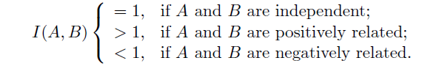


Interest Factor
The interest factor is also called as the “lift”.
s(A) × s(B) = s_{indep}(A,B).
Hence, the interest factor measures the ratio of the support of a pattern s(A,B) against its baseline support s_{indep}(A,B) computed under the statistical independence assumption.
we can interpret the measure as follows:
For the tea-coffee example, -> slightly negative relationship
For the tea-honey example, -> strong positive relationship
The interest factor has a number of statistical advantages over the confidence measure that make it a suitable measure for analyzing statistical independence between variables.

Slide 9

Piatesky-Shapiro (PS) Measure
Instead of computing the ratio between s(A,B) and s_{indep}(A,B) = s(A)× s(B), the PS measure considers the difference between s(A,B) and s(A) × s(B) as follows.
PS value 0 when A and B are mutually independent of each other.
>0 when there is a positive relationship between the two variables
< 0 when there is a negative relationship.

Slide 10


Correlation Analysis
One of the most popular techniques for analyzing relationships between a pair of variables.
For continuous variables, correlation is defined using Pearson’s correlation coefficient.
For binary variables, correlation can be measured using the φ-coefficient, which is defined as
The φ-coefficient can be rewritten in terms of the support measures of A, B, and {A,B} as follows:
Notes:
φ-coefficient- Phi coefficient

Slide 11
Correlation Analysis
The numerator in the above equation is identical to the PS measure.
Hence, the φ-coefficient can be understood as a normalized version of the PS measure, where that the value of the φ-coefficient ranges from −1 to +1.
From a statistical viewpoint, the correlation captures the normalized difference between s(A,B) and s_{indep}(A,B).
A correlation value of 0 means no relationship.
A value of +1 suggests a perfect positive relationship.
A value of −1 suggests a perfect negative relationship.

Slide 12

IS Measure
An alternative measure for capturing the relationship between s(A,B) and s(A) × s(B).
The IS measure is defined as follows:
IS is the geometric mean between the interest factor and the support of a pattern, IS is large when both the interest factor and support are large.
If the interest factor of two patterns are identical, the IS has a preference of selecting the pattern with higher support.
IS is mathematically equivalent to the cosine measure for binary .
The value of IS thus varies from 0 to 1, where an IS value of 0 corresponds to no co-occurrence of the two variables, while an IS value of 1 denotes perfect relationship, since they occur in exactly the same transactions.

Slide 13
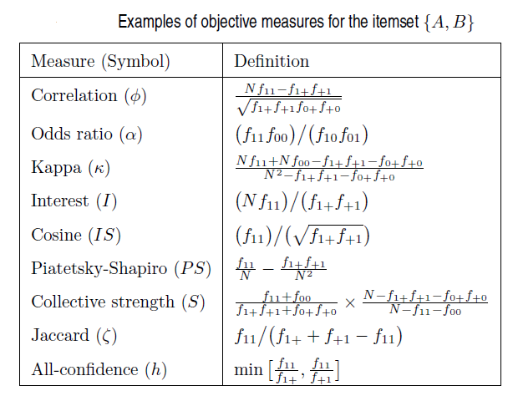

Slide 14
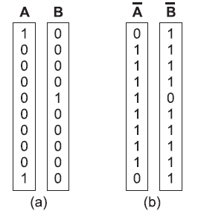
Properties of Objective Measures
Inversion Property
An objective measure M is invariant under the inversion operation if its value remains the same when exchanging the frequency counts f₁₁ with f₀₀ and f₁₀ with f₀₁.
Applying transformation to a binary vector is called inversion.
If a measure is invariant under the inversion operation, then its value for the vector pair {A,B} should be identical to its value for {A,B}.
Measures that are invariant to the inversion property include the correlation (φ-coefficient), odds ratio, κ, and collective strength.
These measures are especially useful in scenarios where the presence (1’s) of a variable is as important as its absence (0’s).
Measures that do not remain invariant under the inversion operation include the interest factor and the IS measure.
Notes:
No measure is universally best for all applications.
Certain properties of the measure play an important role in determining if they are suited for a certain application.

Slide 15
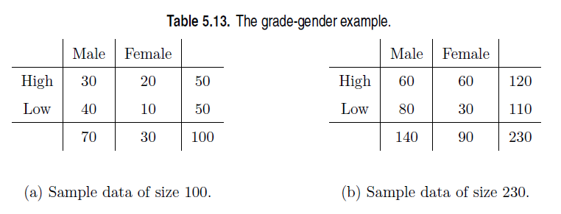
Properties of Objective Measures
Scaling Invariance Property
Let T be a contingency table with frequency counts [f₁₁; f₁₀; f₀₁; f₀₀].
Let T‘ be the transformed contingency table with scaled frequency counts [k₁k₃f₁₁; k₂k₃f₁₀; k₁k₄f₀₁; k₂k₄f₀₀], where k₁, k₂, k₃, k₄ are positive constants used to scale the two rows and the two columns of T.
An objective measure M is invariant under the row/column scaling operation if M(T) = M(T’).
A row or column scaling may be performed in the contingency tables.
Only the odds ratio (α) is invariant to row and column scaling operations.
φ-coefficient, κ, IS, interest factor, and collective strength (S) change their values
Odds ratio is a preferred choice of measure in the medical domain, where it is important to find relationships that do not change with differences in the population sample chosen for a study.

Slide 16
Properties of Objective Measures
Null Addition Property
An objective measure M is invariant under the null addition operation if it is not affected by increasing f₀₀, while all other frequencies in the contingency table stay the same.
Measures that satisfy -cosine (IS) and Jaccard (ξ) measures
Measures that violate this property include interest factor, PS, odds ratio, and the φ-coefficient.

Slide 17
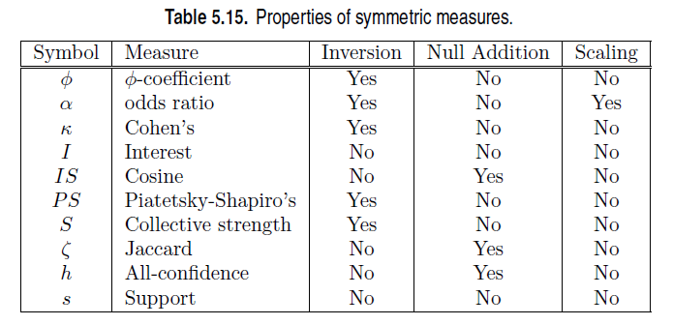
Properties of Objective Measures

Slide 18
Asymmetric Interestingness Measures
If M is a measure and A and B are two variables, then M(A,B) is equal to M(B,A) if the order of the variables does not matter. Such measures are called symmetric.
Measures that depend on the order of variables (M(A,B) ≠ M(B,A)) are called asymmetric measures.
For example, the interest factor is a symmetric measure because its value is identical for the rules A → B and B → A.
In contrast, confidence is an asymmetric measure since the confidence for A → B and B → A may not be the same.
Asymmetric measures are more suitable for analyzing association rules, since the items in a rule do have a specific order.

Slide 19
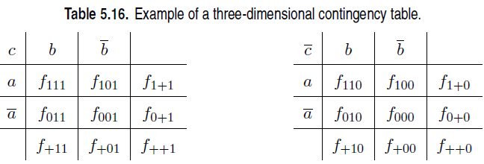

Measures beyond Pairs of Binary Variables
Some Measures are defined for pairs of binary variables others like support and all-confidence, are also applicable to larger-sized itemsets.
Measures such as interest factor, IS, PS, and Jaccard coefficient, can be extended to more than two variables using the frequency tables tabulated in a multidimensional contingency table.
Given a k-itemset {i₁, i₂, . . . , i_{k}}, the condition for statistical independence can be stated as follows:

Slide 20
Measures beyond Pairs of Binary Variables
Analysis of multidimensional contingency tables is more complicated because of the presence of partial associations in the data.
For example, some associations may appear or disappear when conditioned upon the value of certain variables.
This problem is known as Simpson’s paradox

Slide 21
Simpson’s paradox
When interpreting the association between variables , the observed relationship may be influenced by the presence of other confounding factors, i.e., hidden variables that are not included in the analysis.
In some cases, the hidden variables may cause the observed relationship between a pair of variables to disappear or reverse its direction.
This phenomenon is known as Simpson’s paradox.

Slide 22
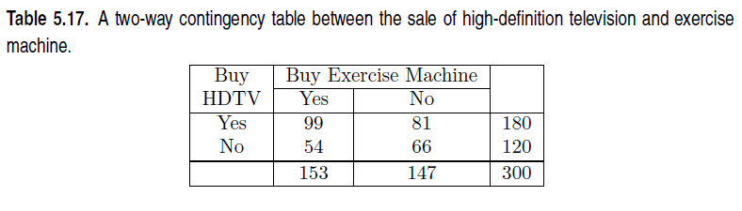
The rule {HDTV=Yes}→ {Exercise machine=Yes} has a confidence of 99/180 = 55% and the rule {HDTV=No} → {Exercise machine=Yes} has a confidence of 54/120 = 45%.
Together, these rules suggest that customers who buy high-definition televisions are more likely to buy exercise machines than those who do not buy high-definition televisions.

Slide 23
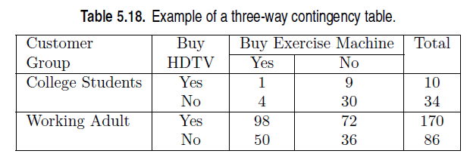
The total column adds upto 300.
There are more working adults than college students who buy these items.
For college students:
C ({HDTV=Yes} → {Exercise machine=Yes}) = 1/10 = 10%,
C ({HDTV=No} −→ {Exercise machine=Yes})= 4/34 = 11.8%,
For working adults:
C ({HDTV=Yes} −→ {Exercise machine=Yes})= 98/170 = 57.7%,
C ({HDTV=No} −→ {Exercise machine=Yes})= 50/86 = 58.1%.
Inference: For each group, customers who do not buy high definition televisions are more likely to buy exercise machines, which contradicts the previous conclusion when data from the two customer groups are pooled together.
This reversal in the direction of association is known as Simpson’s paradox.
Notes:
The paradox can be explained in the following way. First, notice that most customers who buy HDTVs are working adults. This is reflected in the high confidence of the rule {HDTV=Yes} → {Working Adult} (170/180 = 94.4%). Second, the high confidence of the rule {Exercise machine=Yes} → {Working Adult} (148/153 = 96.7%) suggests that most customers who buy exercise machines are also working adults. Since working adults form the largest fraction of customers for both HDTVs and exercise machines, they both
look related and the rule {HDTV=Yes} → {Exercise machine=Yes} turns out to be stronger in the combined data than what it would have been if the data is stratified. Hence, customer group acts as a hidden variable that affects both the fraction of customers who buy HDTVs and those who buy exercise machines. If we factor out the effect of the hidden variable by stratifying the data, we see that the relationship between buying HDTVs and buying exercise machines is not direct, but shows up as an indirect consequence of the effect of the hidden variable.

Slide 24
Simpson’s paradox
The Simpson’s paradox can also be illustrated mathematically as follows.
Suppose : a/b < c/d and p/q < r/s
where a/b and p/q may represent the confidence of the rule A → B in two different strata, while c/d and r/s may represent the confidence of the rule A → B in the two strata.
When the data is pooled together, the confidence values of the rules in the combined data are (a+p)/(b+q) and (c+r)/(d+s), respectively.
Simpson’s paradox occurs when a + p /b + q > c + r/d + s,thus leading to the wrong conclusion about the relationship between the variables.
The lesson here is that proper stratification is needed to avoid generating spurious patterns resulting from Simpson’s paradox.
Eg: supermarket->stratified according to store location
Medical records -> stratified according to age and gender

Slide 25
Association Using Orange Tool
https://www.youtube.com/watch?v=WVS24l1zKZU

